Slide 1
SOFTWARE DEFECT
PREDICTION
A machine-learning study on the NASA JM1 dataset
Presented by:
Instructor:
Dr. Wael Karam
Yasseen Mohamed
Hazem Hisham
Yousef Khaled

Slide 2
AGENDA
01
Introduction — what is software defect prediction?
02
Dataset overview — first look at the raw data
03
What do the columns mean? — all 22 features explained
04
Data preprocessing — duplicates, missing values, outliers
05
Correlation analysis
06
Feature selection
07
Handling class imbalance (SMOTE)
08
Supervised models — Decision Tree, Naive Bayes, Logistic Regression, Neural Network, Random Forest, Gradient Boosting
09
Unsupervised — K-Means clustering
10
Model comparison & conclusion
2

Slide 3
INTRODUCTION
This project builds a machine-learning pipeline that predicts whether a software module is likely to contain a defect. Predicting defects early lets quality-assurance teams focus testing effort on the riskiest modules, reducing cost and improving reliability.
We use the NASA JM1 dataset from the Metrics Data Program — one of the most widely studied benchmarks for software defect prediction. JM1 captures classical static-code metrics extracted from a real-time predictive ground system written in C.
Three families of features describe each module:
DATASET AT A GLANCE
13,204
modules (raw)
22
code-metric attributes
~16%
McCabe metrics — cyclomatic, essential and design complexity
Halstead metrics — volume, length, difficulty, effort, time
Line-of-code measures — total LOC, blank lines, comment lines, branch count
defect rate (imbalanced)
1
binary target (defect)
3

Slide 4
DATASET OVERVIEW
A first look at the raw data: 13,204 rows and 22 columns before any cleaning.
df.shape
Df.info()
Target
13,204 rows
21 numeric + 1 bool
0: 11,101 1: 2,103
22 columns total
defects column = True/False
Strongly imbalanced — only ~16% defective
df.head() — first 5 rows of the raw dataset (original column names, before renaming)
# | loc | v(g) | ev(g) | iv(g) | n | v | d | lOCode | uniq_Op | branchCount | defects
0 | 1.1 | 1.4 | 1.4 | 1.4 | 1.3 | 1.30 | 1.30 | 2 | 1.2 | 1.4 | False
1 | 1.0 | 1.0 | 1.0 | 1.0 | 1.0 | 1.00 | 1.00 | 1 | 1.0 | 1.0 | True
2 | 72.0 | 7.0 | 1.0 | 6.0 | 198.0 | 1134.13 | 20.31 | 51 | 17.0 | 13.0 | True
3 | 190.0 | 3.0 | 1.0 | 3.0 | 600.0 | 4348.76 | 17.06 | 129 | 17.0 | 5.0 | True
4 | 37.0 | 4.0 | 1.0 | 4.0 | 126.0 | 599.12 | 17.19 | 28 | 11.0 | 7.0 | True
12 of 22 columns shown. Full column list and meanings on the next slides.
4

Slide 5
WHAT DO THE COLUMNS MEAN? (1 / 2)
The column names in the raw file are short codes. Here is what each one actually measures:
McCabe Complexity Metrics — how complicated the code logic is
loc → lines_of_code
Total number of lines of code in the module. Bigger = more complex.
v(g) → cyclomatic_complexity
How many different paths can run through the code. High number = harder to test.
ev(g) → essential_complexity
How messy (unstructured) the code is. Ideally should be 1.
iv(g) → design_complexity
How complex the calls to other modules are. Shows how connected the code is.
Halstead Metrics — measure code complexity based on operators and operands
n → halstead_length
Total count of all operators and operands used in the code.
v → halstead_volume
How much information the code contains (based on length and vocabulary).
l → halstead_level
How abstract the code is. Higher = cleaner abstraction.
d → halstead_difficulty
How hard the code is to write and understand. Higher = harder.
5

Slide 6
WHAT DO THE COLUMNS MEAN? (2 / 2)
Halstead Metrics (continued)
i → halstead_intelligence
How much 'meaning' per unit of effort — a measure of code clarity.
e → halstead_effort
How much mental effort it takes to write or read the code.
b → halstead_bugs
Estimated number of bugs — predicted by Halstead's formula.
t → halstead_time
Estimated time (in seconds) needed to write the code.
Line-Count & Operator/Operand Metrics
lOCode → code_lines
Number of lines that are actual code (not comments or blank).
lOComment → comment_lines
Number of comment lines in the file.
lOBlank → blank_lines
Number of blank (empty) lines.
locCodeAndComment → code_comment_lines
Lines that contain both code and a comment together.
uniq_Op → unique_operators
How many distinct operators are used (e.g. +, -, *, if, while).
uniq_Opnd → unique_operands
How many distinct variables and values are used.
total_Op → total_operators
Total count of all operator uses (includes repeats).
total_Opnd → total_operands
Total count of all operand uses (includes repeats).
branchCount → branch_count
Number of branches (if/else/for/while decisions) in the code.
6
TARGET: 1 = the module had a bug, 0 = no bug found.

Slide 7
DATA PREPROCESSING — DUPLICATES
Step 1 — check for and remove exact duplicate rows
DUPLICATES
WHAT IS A DUPLICATE?
df.duplicated().sum()
A duplicate row means that exact same code module (with all the same metric values) was recorded more than once in the dataset.
This happens because the original NASA dataset merged measurements from multiple extraction runs.
We simply drop the extra copies and keep just one version of each unique module.
4,296
exact duplicate rows found
13,204 → 8,908 rows
Why remove them? If the same row appears in both training and test sets, the model cheats — it has already 'seen' the answer.
7

Slide 8
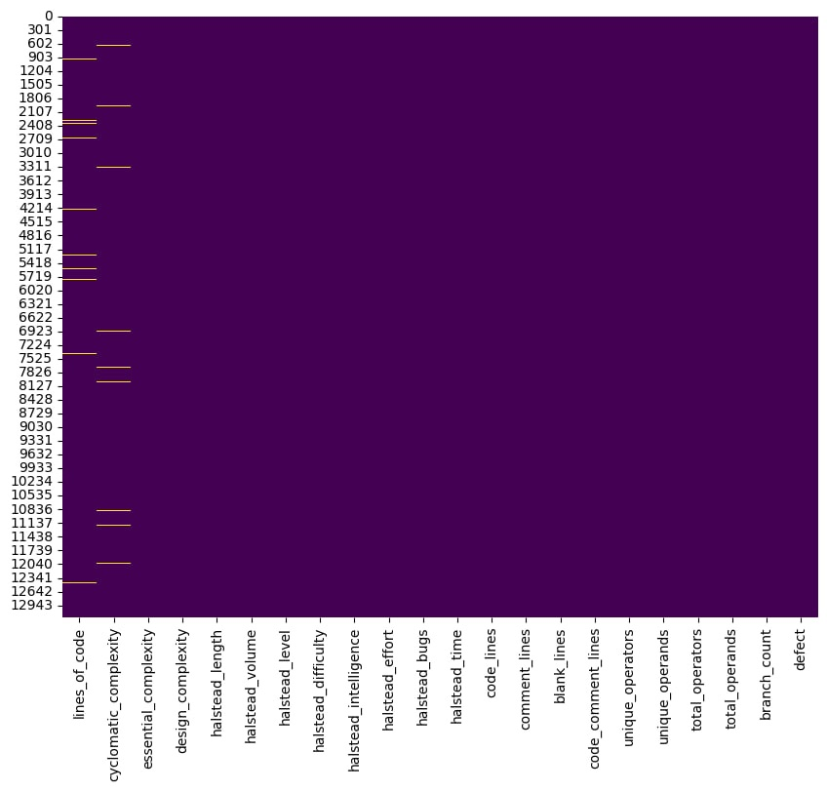
MISSING VALUES — STEP 1: Adding
We Added missing values in the first two features by the rate of 2%
Missing-value heatmap (df.isnull() — yellow = missing)
What does the heatmap show?
Each row = one data row. Each column = one feature.
Yellow dot = a missing value at that position.
In the original JM1 data most columns are fine. Missing values were intentionally added to a few key columns to practice the handling step.
# Check missing values
df.isnull().sum()
→ 8 columns had missing values
(lines_of_code, cyclomatic_complexity,
halstead_length, halstead_volume,
halstead_difficulty, total_operators,
total_operands, branch_count)
8

Slide 9
MISSING VALUES — STEP 2: HANDLE
We filled each missing value with the median of its column.
feature_cols = [
'lines_of_code',
'cyclomatic_complexity',
'halstead_length',
'halstead_volume', ...
]
for col in feature_cols:
df[col] = df[col].fillna(
df[col].median())
Why use the median?
Option 1 — delete the row.
Loses data. Not ideal when the dataset is small.
Option 2 — fill with mean.
Can be pulled by extreme values (outliers).
Option 3 — fill with median. ✓
The middle value is not affected by outliers. Software metrics like lines_of_code are very skewed, so the median is the safer and more honest choice.
After filling → df.isnull().sum() shows 0 for every column.
No missing values remain. The dataset is clean and ready for outlier handling.
9

Slide 10
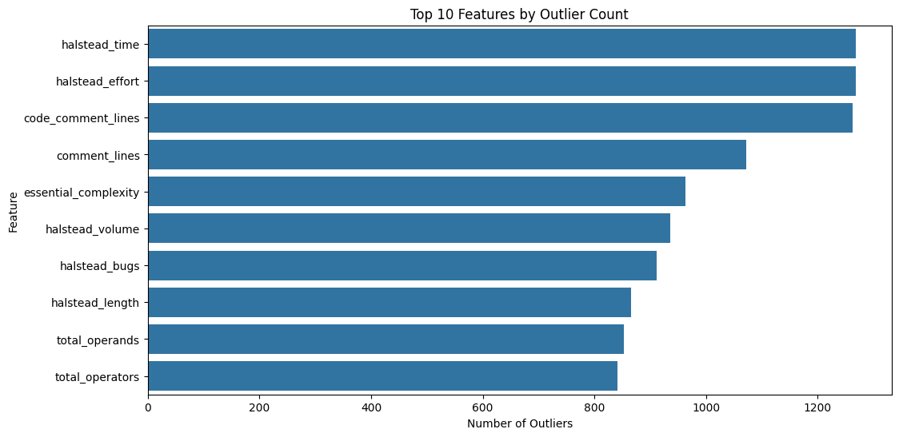
OUTLIER DETECTION
We used the IQR method: any value below Q1 − 1.5×IQR or above Q3 + 1.5×IQR is counted as an outlier.
Top features by outlier count (from IQR analysis)
Feature | # Outliers | % of Data
halstead_time | 1,269 | 14.25%
halstead_effort | 1,269 | 14.25%
code_comment_lines | 1,262 | 14.17%
comment_lines | 1,072 | 12.03%
essential_complexity | 963 | 10.81%
halstead_volume | 936 | 10.51%
halstead_bugs | 912 | 10.24%
halstead_length | 865 | 9.71%
total_operands | 853 | 9.58%
total_operators | 842 | 9.45%
blank_lines | 815 | 9.15%
lines_of_code | 741 | 8.32%
Notebook chart — cell 13
These are real extreme modules — not errors. Up to 14% outlier rate is high, so we cap (not delete) them on the next slide.
10

Slide 11
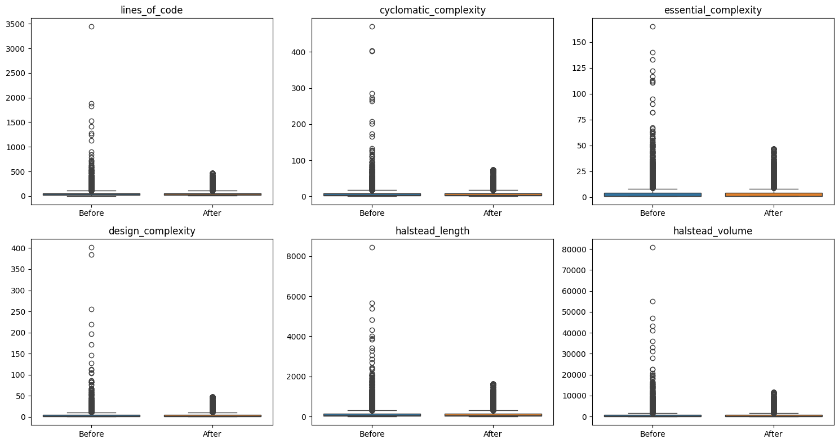
OUTLIER HANDLING
Conservative quantile capping — clip each feature to its [0.5 % , 99.5 %] range
Before vs after capping (notebook cell 15)
for col in feature_cols:
lower = df[col]
.quantile(0.005)
upper = df[col]
.quantile(0.995)
df[col] = df[col]
.clip(lower, upper)
Why capping (not dropping)?
Extreme modules are real and informative. Capping preserves the row, just tames the tail so distance- and gradient-based models stay stable.
8

Slide 12
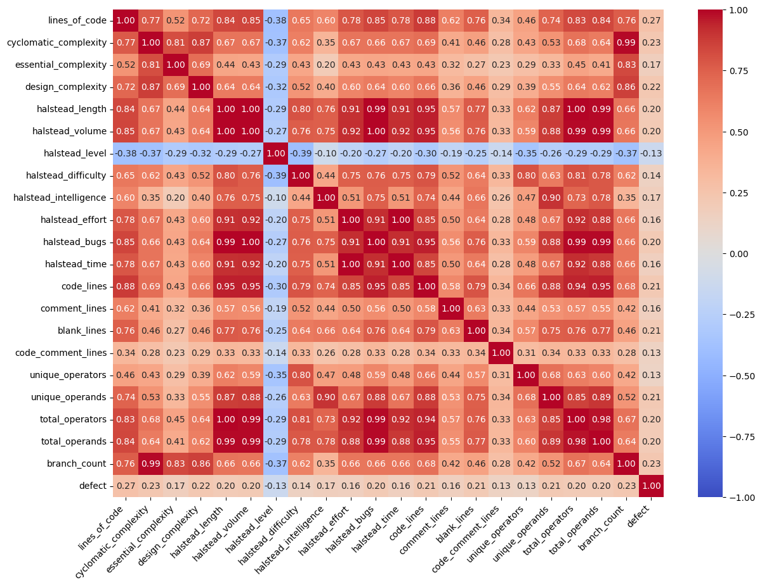
CORRELATION
Heatmap of Pearson correlations among the 21 numeric features
Correlation heatmap (notebook cell 16)
Key takeaways
Halstead family (length, volume, effort, time, bugs) shows r ≈ 0.99 — almost perfectly collinear.
lines_of_code, code_lines and the Halstead block also move together (r ≈ 0.85 – 0.95).
cyclomatic_complexity ↔ branch_count = 0.99 — branchCount is essentially derived.
halstead_level is the only inversely-related feature (r ≈ −0.3 with the rest).
Correlations with the target stay modest (|r| ≤ 0.27) — no single feature is decisive.
9

Slide 13
FEATURE SELECTION
Random-Forest feature importance, computed on the training split only (no leakage)
20 / 21
features kept (importance > 0.02)
Decision rule
selected = importances
[importances > 0.02]
Only code_comment_lines fell below the cutoff and was dropped.
10

Slide 14
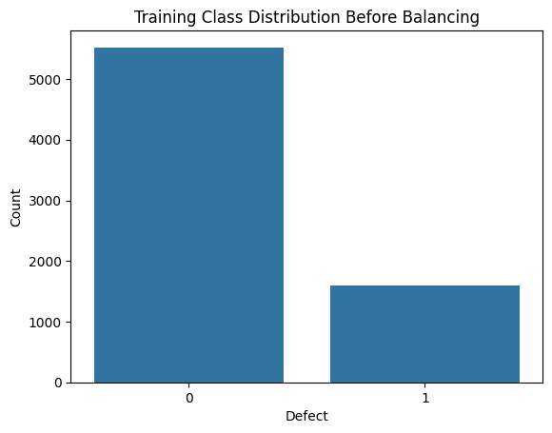
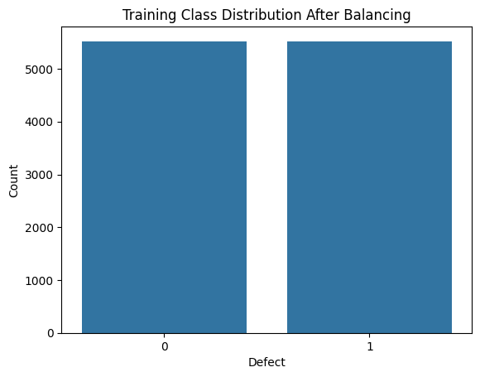
HANDLING CLASS IMBALANCE
SMOTE — synthesise new minority examples in feature space
Before SMOTE
After SMOTE
Why SMOTE?
Training set was 77 % clean / 23 % defective. A model could reach 77 % accuracy by predicting ‘clean’ every time — but miss every real bug.
SMOTE interpolates k-nearest defective neighbours to generate plausible synthetic defective modules, restoring a 1 : 1 ratio.
Applied to TRAIN only — the test set keeps its real-world proportions.
0: 5,523 1: 1,603
0: 5,523 1: 5,523
11

Slide 15






MODELS WE TRAINED
Six supervised classifiers and one clustering algorithm, all evaluated on the same held-out test split
Decision Tree
Naive Bayes
Logistic Regression
Interpretable rule-based baseline
Fast probabilistic baseline
Linear, well-calibrated probabilities
Neural Network
Random Forest
Gradient Boosting
MLP — 2 hidden layers (64, 32)
Bagged ensemble of 100 trees
Sequential ensemble — usually best on JM1
Plus K-Means Clustering — an unsupervised look at the structure of the feature space.
12

Slide 16
HOW DO WE MEASURE A MODEL?
Accuracy, Precision, Recall and F1-score explained simply
The Confusion Matrix
ACCURACY
Predicted Clean
Predicted defective
TRUE NEGATIVE Predicted: Clean Actual: Clean
FALSE POSITIVE Predicted: defective Actual: Clean
The precentage of ALL predictions that were correct. = (TP+TN) / Total Warning: can be misleading with imbalanced data.
FALSE NEGATIVE Predicted: Clean Actual: defective
TRUE POSITIVE Predicted: defective Actual: defective
PRECISION
Of everything flagged as defective, how many really were? = TP / (TP + FP) High = few false alarms.
In this project, Recall matters most — missing a real bug is usually more costly than a false alarm.
RECALL
Of all REAL defects, how many did we catch? = TP / (TP + FN) High = few missed bugs. Most important for QA!
F1-SCORE
Balances Precision and Recall into one score. = 2 x (Precision x Recall) / (P + R) Use when both false alarms and missed defects matter.

Slide 17

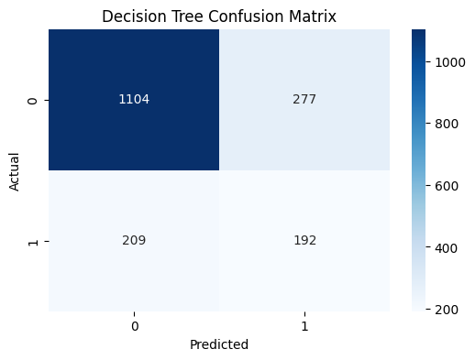
DECISION TREE
DecisionTreeClassifier(max_depth=5, random_state=42) — trained on SMOTE-balanced data
How it works: Builds a tree of yes/no questions on your features. Splits the data step by step, choosing the feature that best separates clean from buggy modules. Easy to visualise and explain.
ACCURACY
72.7%
Classification report
Class | Precision | Recall | F1-score | Support
0 (clean) | 84% | 80% | 82% | 1381
1 (defect) | 41% | 48% | 44% | 401
on the held-out test set
Confusion matrix (notebook)
• Splits early on lines_of_code and Halstead volume; few-leaf rules stay interpretable.
• Limited depth keeps it from over-fitting but caps the F1 of the minority class at ~0.44.
Observations
13

Slide 18

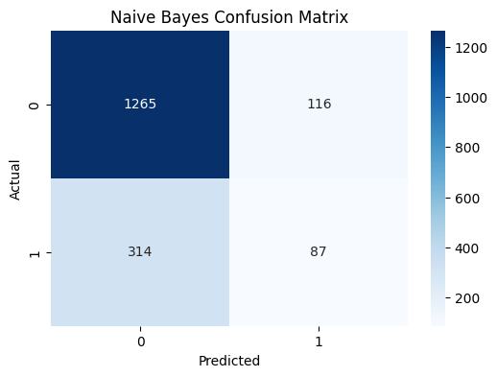
NAIVE BAYES
GaussianNB() — probabilistic baseline assuming feature independence
How it works: Assumes each feature is independent and uses probability theory (Bayes theorem) to decide. Very fast but unreliable when features are correlated — which they are here.
ACCURACY
75.9%
Classification report
Class | Precision | Recall | F1-score | Support
0 (clean) | 80% | 92% | 85% | 1381
1 (defect) | 43% | 22% | 29% | 401
on the held-out test set
• High overall accuracy is misleading — it comes from predicting the majority class.
• Recall on defect = 22 %: 314 of 401 real defects are missed (false negatives).
Confusion matrix (notebook)
Observations
14

Slide 19

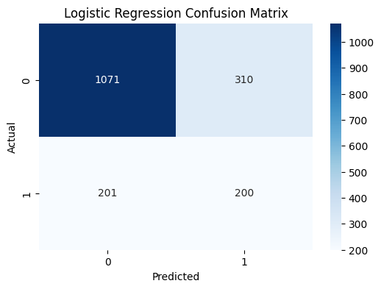
LOGISTIC REGRESSION
LogisticRegression(max_iter=1000) — features standard-scaled inside the pipeline
How it works: Draws a straight line (or hyperplane) to separate clean from buggy modules. Works well when the relationship is simple and linear, but struggles with complex curved boundaries.
ACCURACY
71.3%
Classification report
Class | Precision | Recall | F1-score | Support
0 (clean) | 84% | 78% | 81% | 1381
1 (defect) | 39% | 50% | 44% | 401
on the held-out test set
Confusion matrix (notebook)
Observations
• Roughly balanced recall on both classes — defect recall = 50 %.
• Linear decision boundary is too rigid for non-linear interactions .
15

Slide 20

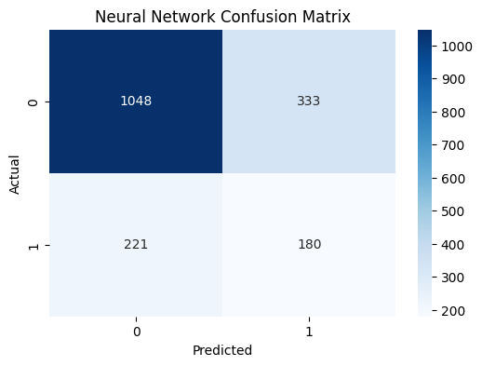
NEURAL NETWORK
MLPClassifier(hidden_layer_sizes=(64, 32), activation='relu', max_iter=500)
How it works: A network of layers that learns patterns by adjusting weights through training. Two hidden layers here (64 then 32 neurons). Powerful in theory, but needs a lot of data to shine.
ACCURACY
68.9%
Classification report
Class | Precision | Recall | F1-score | Support
0 (clean) | 83% | 76% | 79% | 1381
1 (defect) | 35% | 45% | 39% | 401
on the held-out test set
Confusion matrix (notebook)
Observations
• Capable in principle of capturing non-linear interactions — but JM1 is small for an MLP, so it underperforms.
• Class-1 recall (45 %) is decent but precision drops to 35 %, producing many false alarms.
16

Slide 21

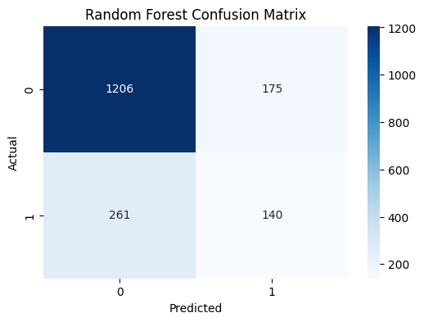
RANDOM FOREST
RandomForestClassifier(n_estimators=100, random_state=42) — bagged ensemble of decision trees
How it works: Builds 100 decision trees on random subsets of data and features, then takes a majority vote. Each tree sees slightly different data, so errors cancel out — much stabler than a single tree.
ACCURACY
75.5%
Classification report
Class | Precision | Recall | F1-score | Support
0 (clean) | 82% | 87% | 85% | 1381
1 (defect) | 44% | 35% | 39% | 401
on the held-out test set
Confusion matrix (notebook)
Observations
• Best precision-class-1 of the un-tuned models (44 %).
• Native feature-importance scores guided our feature-selection step.
17

Slide 22

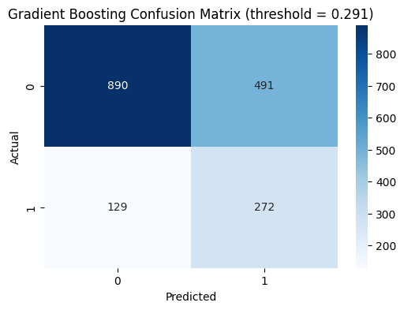
GRADIENT BOOSTING
GradientBoostingClassifier(n_estimators=300, max_depth=4, lr=0.05) — threshold tuned to 0.291
How it works: Builds trees one at a time, where each new tree focuses on fixing the mistakes of the previous ones. Slower to train but typically the most accurate. Threshold was tuned to 0.291 to catch more bugs.
ACCURACY
65.2%
Classification report
Class | Precision | Recall | F1-score | Support
0 (clean) | 87% | 64% | 74% | 1381
1 (defect) | 36% | 68% | 47% | 401
on the held-out test set
Confusion matrix (notebook)
Observations
• Recall on the defective class jumps to 68 % — only 129 real defects missed.
• Threshold lowered to 0.291 to prioritise catching bugs at the cost of more false alarms.
• Best F1-score on class 1 across all six models (0.47).
• Right choice when missing a defect is more costly than running extra tests.
18

Slide 23
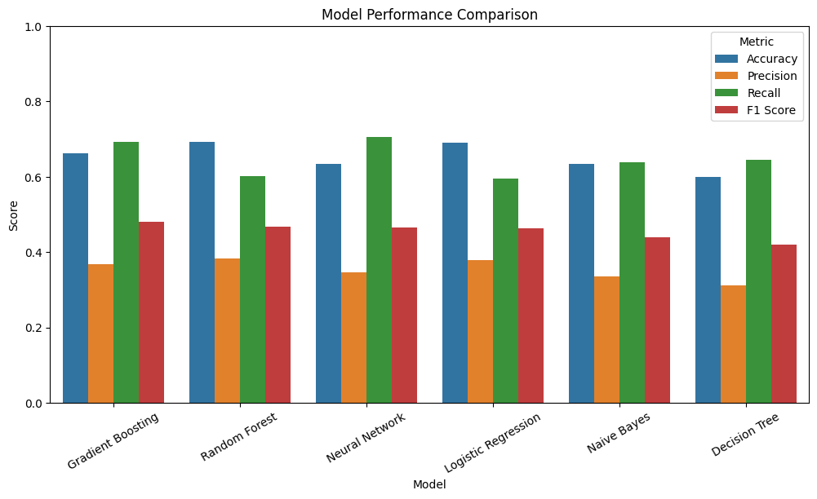
MODEL COMPARISON
Final evaluation with F1-optimised thresholds — sorted by F1-score of the defective class
Ranked by F1 (defect class)
1.
Gradient Boosting
0.481
2.
Random Forest
0.468
3.
Neural Network
0.465
4.
Logistic Reg.
0.464
5.
Naive Bayes
0.440
6.
Decision Tree
0.420
Winner: Gradient Boosting (F1 = 0.48, recall = 69 %) — best at catching real defects while keeping false alarms manageable.
Notebook output — cell 37
20

Slide 24
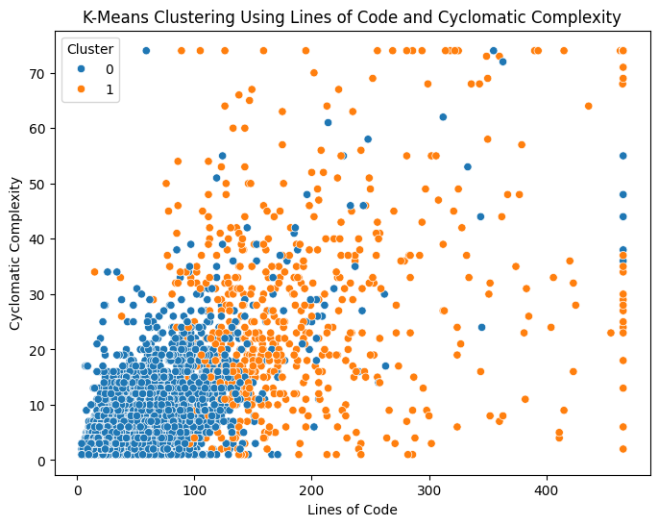
K-MEANS CLUSTERING
Unsupervised structure check — KMeans(n_clusters=2) on standard-scaled features
Cluster scatter (cell 29)
Cluster ↔ defect
0.71
 | Def=0 | Def=1
C 0 | 6,600 | 1,716
C 1 | 304 | 288
19

Slide 25
K-MEANS CLUSTERING
K-Means was used to see if the code modules naturally split into groups based on their features, without using the defect label.
Cluster ↔ defect
Cluster scatter (cell 29)
 | Def=0 | Def=1
C 0 | 6,600 | 1,716
C 1 | 304 | 288
For Cluster 0:
It has many clean samples and some buggy samples.
Defect rate:
1716 / (6600 + 1716) ≈ 20.6%
So Cluster 0 is mostly clean.
For Cluster 1:
It has 304 clean and 288 buggy samples.
Defect rate:a
288 / (304 + 288) ≈ 48.6%
So Cluster 1 has a much higher bug rate.
0.71
19

Slide 26




CONCLUSION
What worked
Careful preprocessing — duplicate removal (4,296 → 0), median imputation, quantile capping — gave a clean, leakage-free 8,908-row table. SMOTE successfully rebalanced training data from 77/23 % to 50/50 %.
Best model
Gradient Boosting with a tuned threshold of 0.291 reached F1 = 0.48 and recall = 69 % on the defective class — the most useful operating point for software QA.
Why simple models struggled
Naive Bayes is broken by heavy collinearity among Halstead metrics; Logistic Regression cannot model the non-linear interaction between size and complexity; an MLP is too data-hungry for ~7 k training rows.
What we learned about JM1
lines_of_code dominates importance (≈ 12.6 %), followed by Halstead intelligence, volume and time. Defects concentrate in long, dense modules — exactly what McCabe and Halstead hypothesised in the 1970s.
21

Slide 27
THANK
YOU
Questions are welcome.

